Slide 1
Null Hypothesis Significance Testing
Martina Sladekova

Slide 2
Today
Recap of sampling from distributions and confidence intervals
Forming a research question
Moving from research questions to hypotheses
Formally testing hypotheses with statistics
(Some of many) pitfalls of NHST

Slide 3
Recap
WEEK 1: Determining whether an individual’s score is unusual given a distribution with known characteristics.

Slide 4
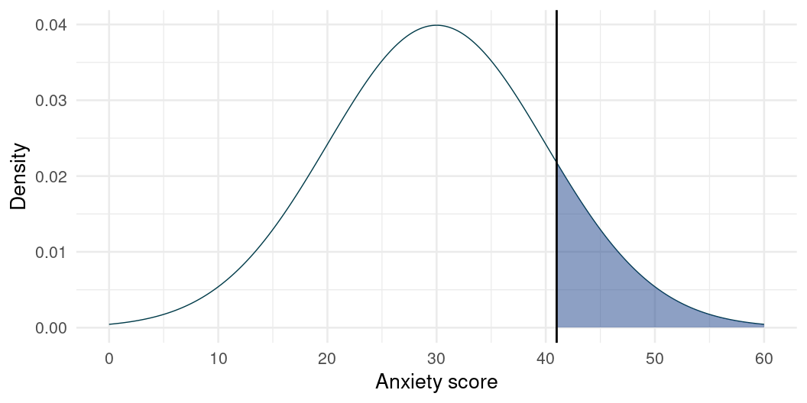
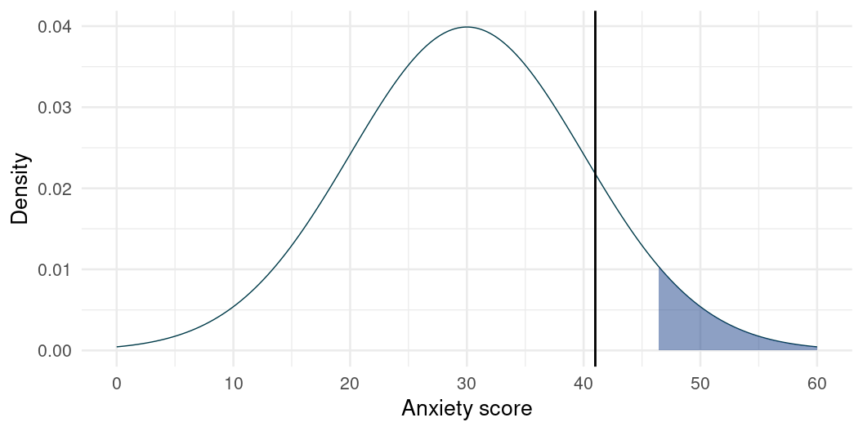
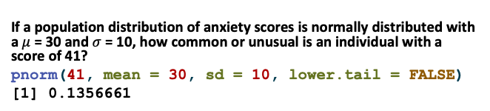
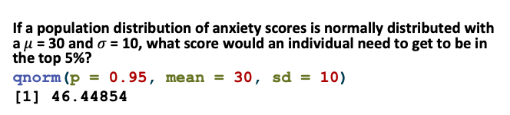
If a population distribution of anxiety scores is normally distributed with a $μ$ = 30 and $σ$ = 10, how common or unusual is an individual with a score of 41?
pnorm(41, mean = 30, sd = 10, lower.tail = FALSE)
[1] 0.1356661
If a population distribution of anxiety scores is normally distributed with a $μ$ = 30 and $σ$ = 10, what score would an individual need to get to be in the top 5%?
qnorm(p = 0.95, mean = 30, sd = 10)
[1] 46.44854

Slide 5
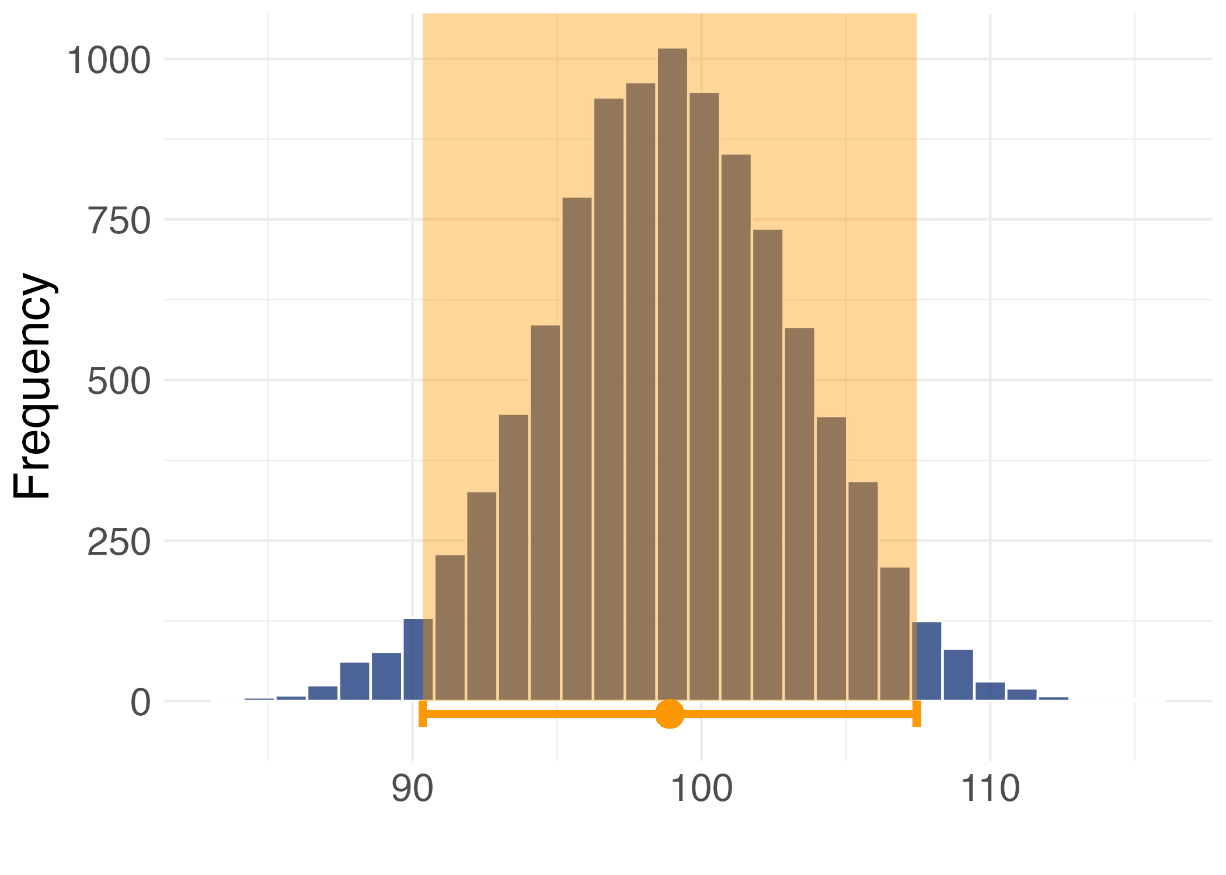
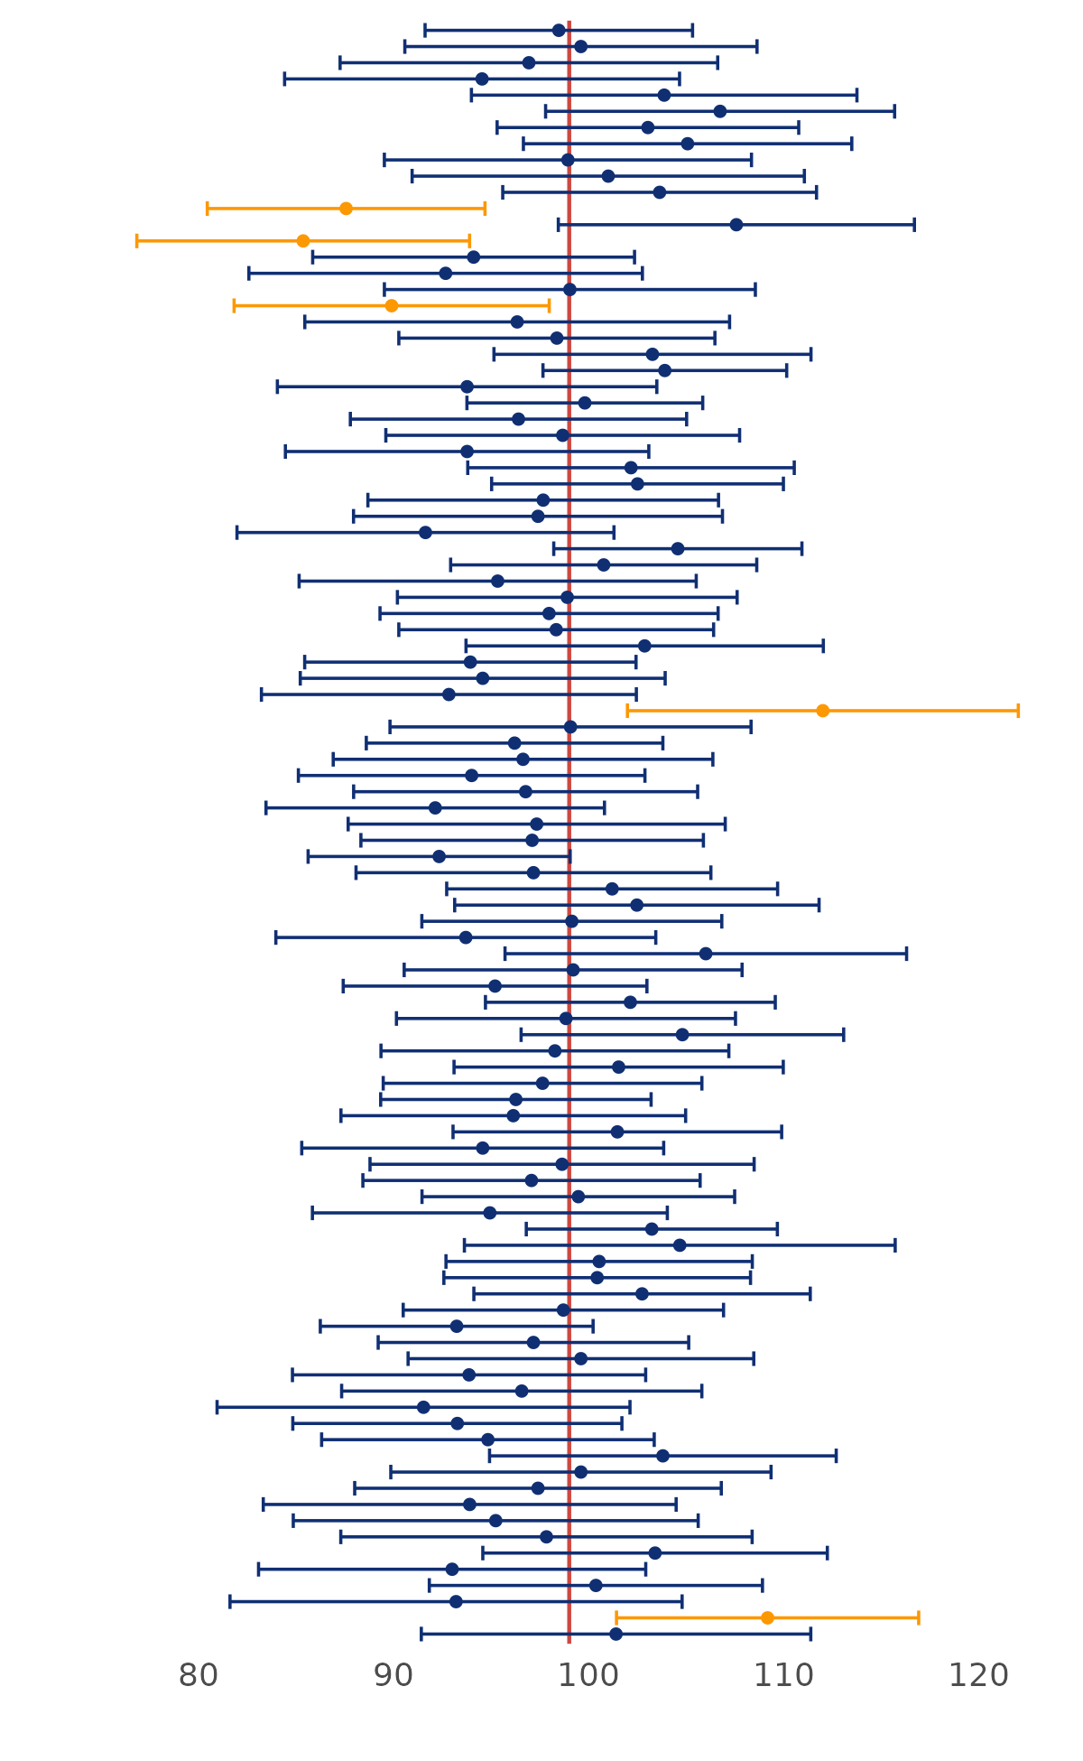
WEEK 2: Estimating population distribution properties from the sample and quantifying uncertainty around our estimates.
Sample estimate - some numeric value we calculate based on the sample. We want to use this value to generalise to the population.
Standard error is the standard deviation of sample means (in a sampling distribution)
Constructing confidence intervals around our sample estimate.

Slide 6
What’s the point? Dealing with uncertainty in science
We don’t know how close our estimate is to the population value
We also don’t know if our confidence interval even contains a population value.
Should we even bother?
TO THE RESCUE:
Sample size
Team effort

Slide 7
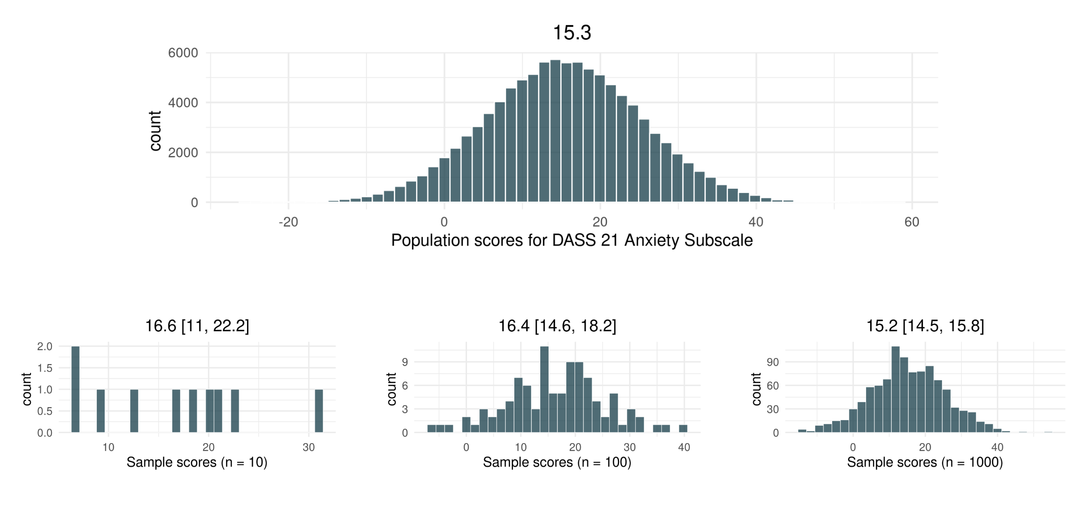
What’s the point? - sample size
Sample size matters - the larger our sample size, the closer our sample resembles the distribution.

Slide 8
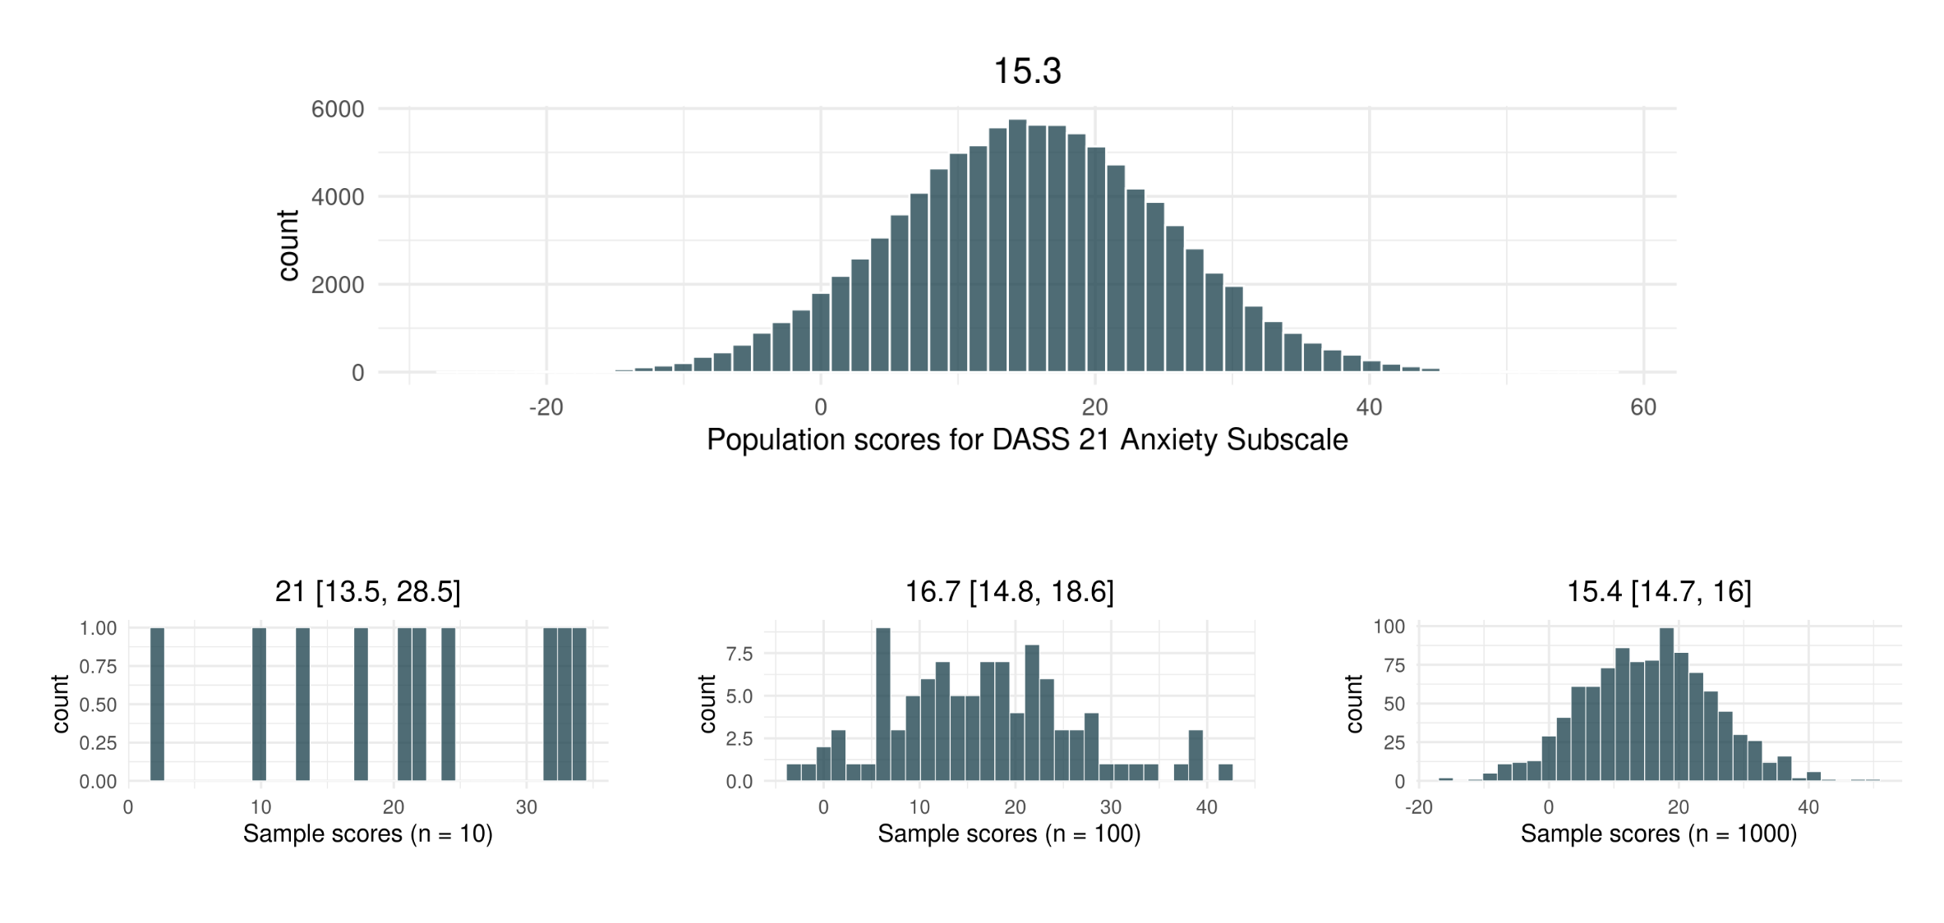
What’s the point? - sample size
Sample size matters - the larger our sample size, the closer our sample resembles the distribution.

Slide 9
What’s the point? - team effort
Scientific work is cumulative - we build on each others ideas, rarely starting from scratch.
Small samples are not useless, we just need more of them.
Multi-study papers
Multi-lab studies (e.g. SMARVUS data)
Replication is crucial (especially for novel findings)
Vocab
Replication - attempt to reproduce a finding from another study in a new sample using identical methodology

Slide 10
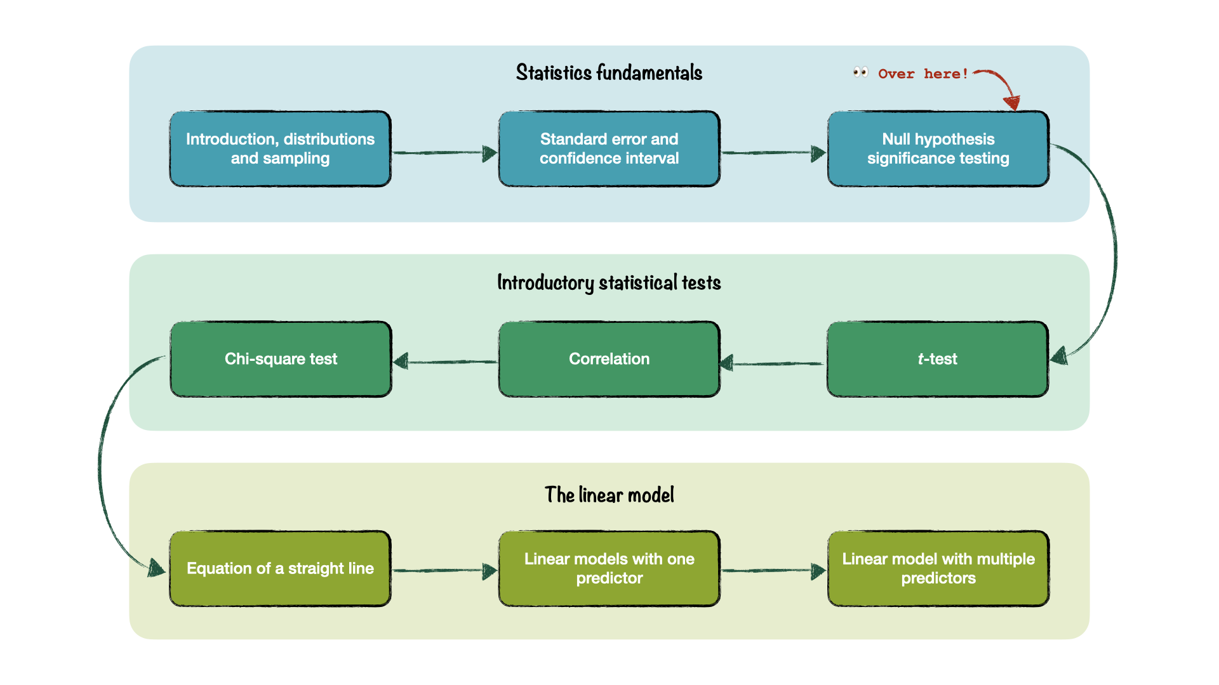
Where are we?

Slide 11
The research process

Slide 12
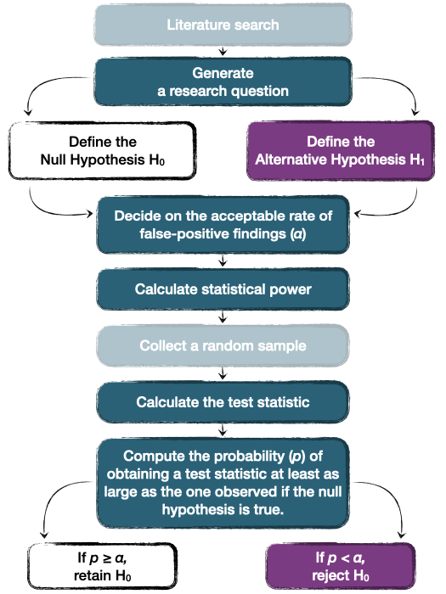
The (quantitative) research process
CONFIRMATORY RESEARCH - focus on testing specific hypotheses and in general follows formula on the right.¹
“Null Hypothesis Significance Testing” (NHST)
Other approaches also exist
EXPLORATORY RESEARCH - doesn’t start with a hypothesis.
Can collect new data or work with existing data.
Useful for generating hypotheses, but statistical tests can be difficult to interpret.

Slide 13
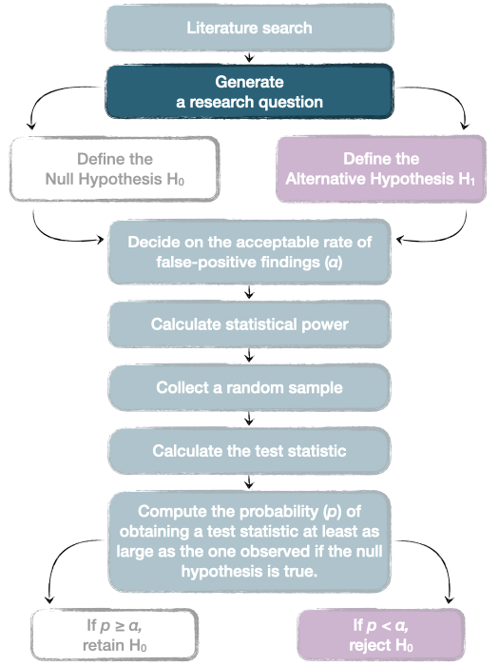
Generate a research question
A good research question:
Researchable and realistic
Informed by the prior research (a gap in the literature or a need for replication)
Not too broad and not too narrow - proportional to the project at hand
What’s too broad for one project can be just right for another!

Slide 14
Generate a research question
Caution
How can we address the global mental health crisis? ❌ - Too broad
Note
What are the key factors contributing to the mental health crisis among PhD students? (Woolston 2019) ✅ - Better!
Some other examples:
Note
Can domesticated cats play fetch? (Forman, Renner, and Leavens 2023)
Note
How do word frequency and semantic transparency influence synaesthetic colouring of compound words? (Mankin et al. 2016)
Note
Can embedding statistical teaching within a fictional narrative help to reduce anxiety and increase comprehension? (Field and Terry 2018)
Note
What are the effects of breathwork on stress and mental health? (Fincham et al. 2023)
Note
What are the roles of socioeconomic status, ethnicity and teacher beliefs in academic grading? (Doyle, Easterbrook, and Harris 2023)
Note
Can a digital intervention be helpful for individuals with subthreshold borderline personality disorder? (Drews-Windeck et al. 2022)
Notes:
Difficult coming up with bad examples, because a lot of research questions can be good given the right settings. It’s context dependent.

Slide 15
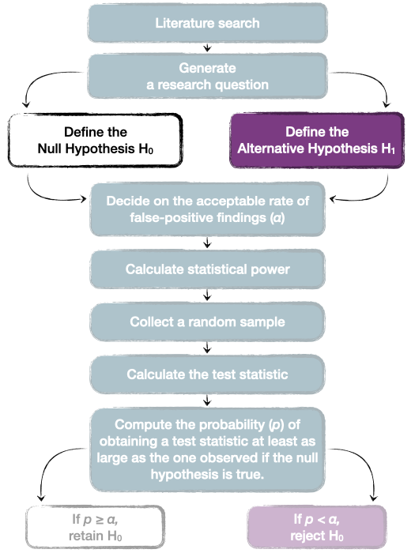
Define the hypotheses
A good research question allows us to generate testable predictions (hypotheses) that are relevant to our research aims.
Vocab
Hypothesis: A testable prediction - a statement about what we reasonably believe our data will show.
The prediction is based on some prior information (literature and prior research)
A hypothesis can be defined on different levels - conceptual, operational, statistical

Slide 16
Define the hypotheses
CONCEPTUAL HYPOTHESIS
Describes our prediction in conceptual terms. Can be defined in terms of the direction of the effect that we’re studying:
“There will be differences in anxiety levels between participants in group A and group B” - non-directional hypothesis.
“Participants in group A will show higher levels of anxiety than those in group B” - directional hypothesis.

Slide 17
Define the hypotheses
OPERATIONALISATION - the process of translating concepts into measures - i.e. how are we going to measure the concepts that we’re studying?
CONCEPTUAL HYPOTHESIS
“Participants in group A will show higher levels of anxiety than those in group B.”
➞
OPERATIONAL HYPOTHESIS
“Participants in group A will score higher on the State-trait anxiety inventory than those in group B” OR:
“Participants in group A will show higher skin conductance response than those in group B”
STATISTICAL HYPOTHESIS
What do we expect to happen numerically? E.g.
MGroupA≠MGroupB�GroupA≠�GroupB OR MGroupA>MGroupB

Slide 18

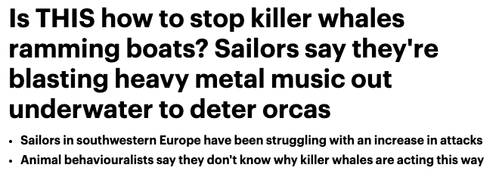
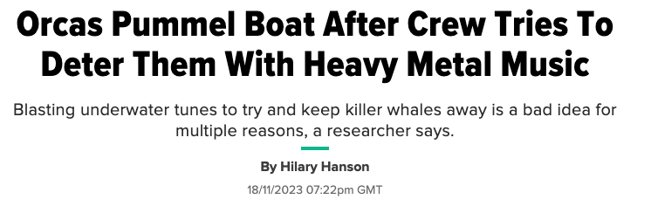
Example: Heavy metal orcas 🤘
Reports of increased orca attacks on boats crossing the Gibraltar Strait
Sailors started using heavy metal to deter them
Mixed anecdotal results - some (less than reputable) sources claim it works. Others advise against doing so!

Slide 19

Example: Heavy metal orcas 🤘
RESEARCH QUESTION: Does heavy metal music affect hostile behaviour in orcas?

Slide 20
Example: Heavy metal orcas 🤘
RESEARCH QUESTION: Does heavy metal music affect hostile behaviour in orcas?
Boat 1: Martina is blasting heavy metal music
Boat 2: Jennifer is blasting Shrek music (control group)
CONCEPTUAL HYPOTHESIS: Playing heavy metal music will be associated with reduced hostility in orcas.
Reduced hostility in orcas ➞ Shorter orca attack duration
OPERATIONAL HYPOTHESIS: Playing heavy metal music will be associated with shorted orca attack duration compared to Shrek music.

Slide 21
Null vs Alternative hypotheses
Once we know the operational hypothesis, we can define the null and the alternative hypotheses.
ALTERNATIVE HYPOTHESIS - our prediction, denoted as H₁.
NULL HYPOTHESIS - denoted as H₀. It represents the negation of the prediction that we’re making. Often describes a reality where the effect we’re interested in doesn’t exist.

Slide 22
H₁: Orca attacks will be significantly shorter when playing heavy metal music compared to playing Shrek soundtracks.
H₀: There will be no significant difference in attack duration between the two music styles.
Tip
H₀ and H₁ represent two alternative realities (like parallel world). When using Null Hypothesis Significance Testing, we’re trying to decide whether we can reject the null hypothesis.

Slide 23
Null vs Alternative hypotheses
STATISTICAL HYPOTHESES:
H₁:
$$M_{\text{(}\text{Shrek}\text{)}}−M_{\text{(}\text{Metal}\text{)}}≠0$$
$$M_{\text{(}\text{Shrek}\text{)}}>M_{\text{(}\text{Metal}\text{)}}$$
H₀:
$$M_{\text{(}\text{Shrek}\text{)}}−M_{\text{(}\text{Metal}\text{)}}=0$$

Slide 24
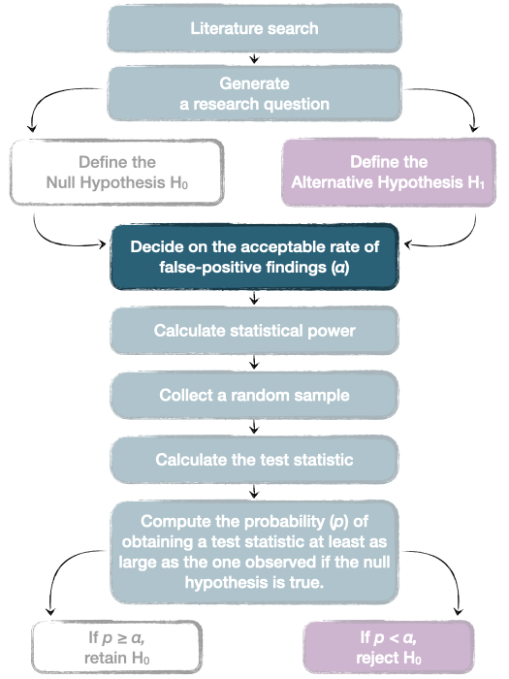
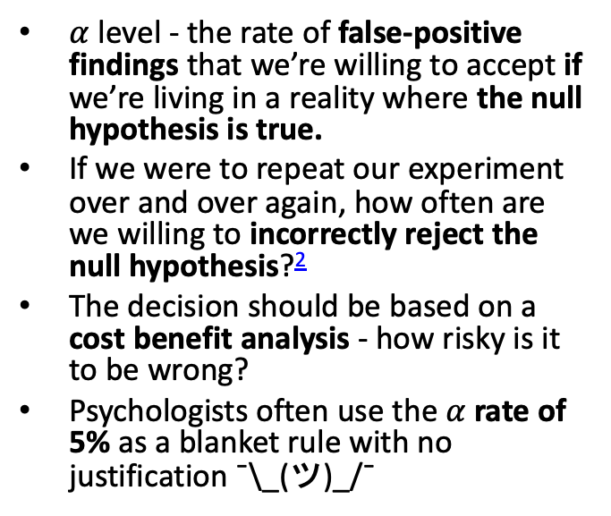
Decide on the α (alpha) level
$α$ level - the rate of false-positive findings that we’re willing to accept if we’re living in a reality where the null hypothesis is true.
If we were to repeat our experiment over and over again, how often are we willing to incorrectly reject the null hypothesis?²
The decision should be based on a cost benefit analysis - how risky is it to be wrong?
Psychologists often use the $α$ rate of 5% as a blanket rule with no justification ¯\_(ツ)_/¯

Slide 25
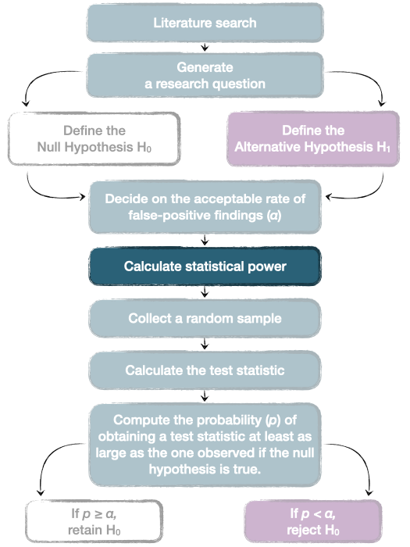
Calculate statistical power
It’s a way of deciding how large a sample you need to get meaningful results on a statistical test.
Let’s come back to this later!

Slide 26
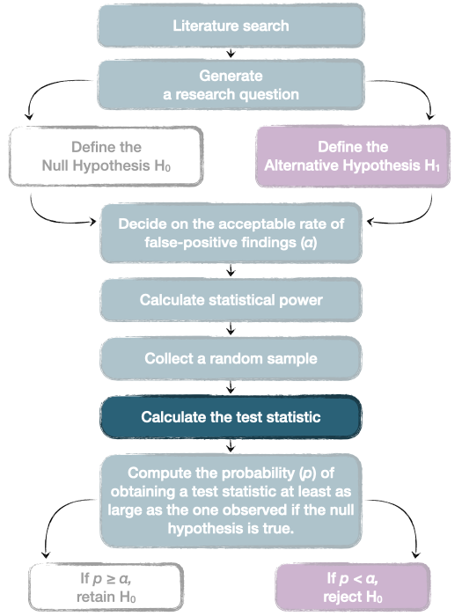
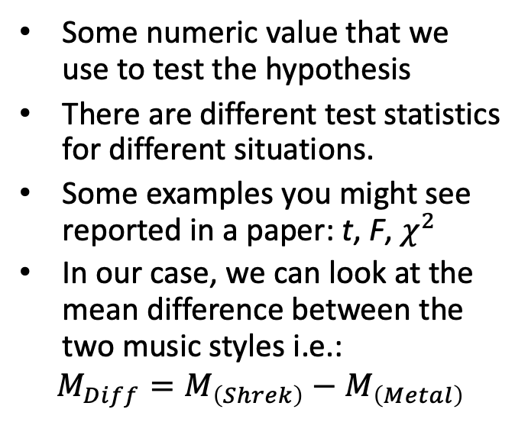
Calculate the test statistic
Some numeric value that we use to test the hypothesis
There are different test statistics for different situations.
Some examples you might see reported in a paper: t, F, $χ^{2}$
In our case, we can look at the mean difference between the two music styles i.e.:
$$M_{Diff}=M_{\left(Shrek\right)}−M_{\left(Metal\right)}$$

Slide 27
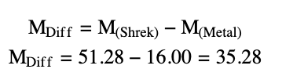
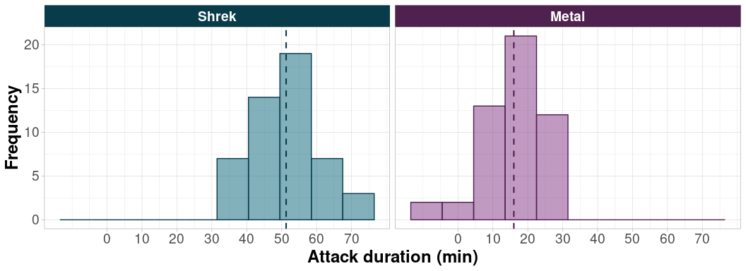
Calculate the test statistic
Example 1:
Over 35 minutes of different is quite a lot!

Slide 28
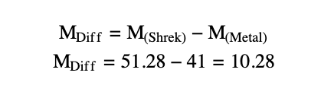
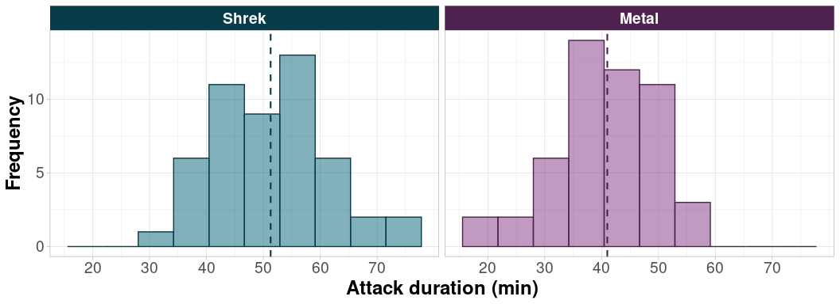
Calculate the test statistic
Example 2:
How about this difference? Large? Small? We need a more formal way of deciding whether we can reject the null hypothesis.

Slide 29
p-values

Slide 30
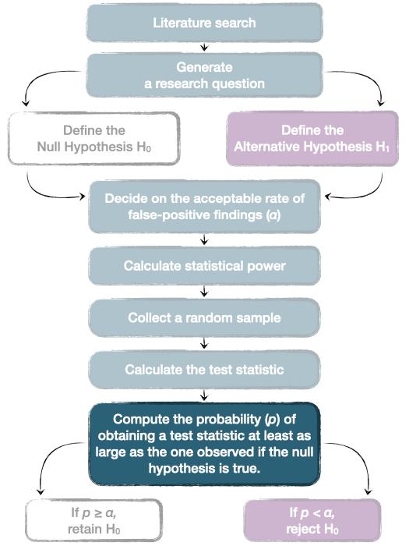
Compute the p-value
Note
H₀: There will be no significant difference in attack duration between the two music styles.
We want to know the probability of observing the test statistic at least as large as the one we observed if the null hypothesis is true - the p-value.
In our case, the “test statistic” is the mean difference between the two groups.
What kind of difference would we expect to find if there the null hypothesis is true?

Slide 31
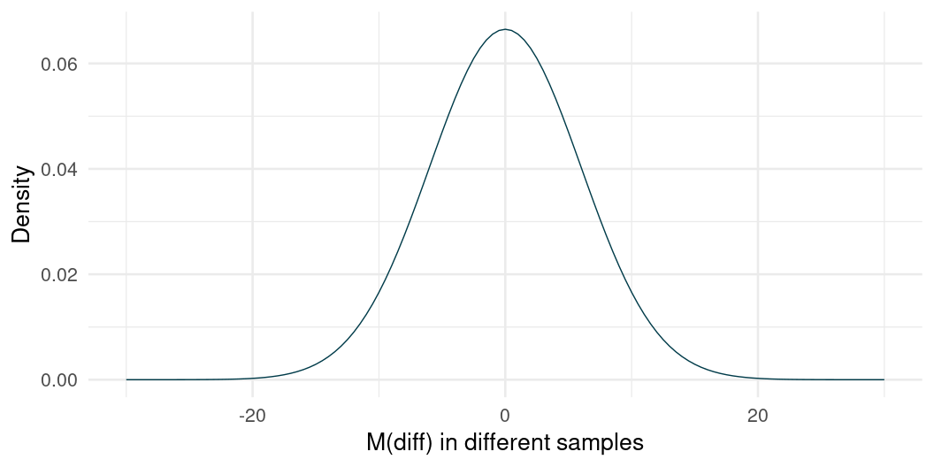
Compute the p-value
If the null hypothesis is true, we would expect a difference of 0
But we’re taking a random sample - so 0 is the most probable value under the null hypothesis but other values are also possible.

Slide 32
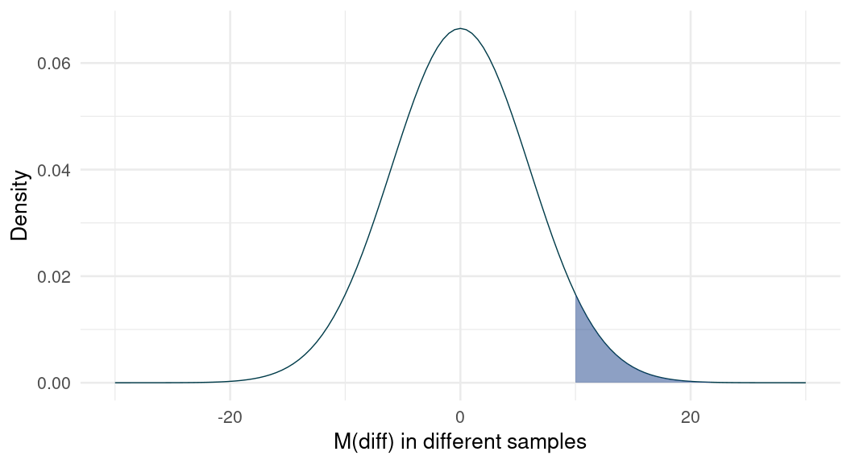
Compute the p-value
pnorm(m_diff, 0, 6, lower.tail = FALSE)
[1] 0.04332562
The difference in attack duration between Shrek music and Metal music detected in our sample was equal to 10.28.
Familiar territory: Given a normal sampling distribution centred at 0, how common is the value of 10.28 ?

Slide 33
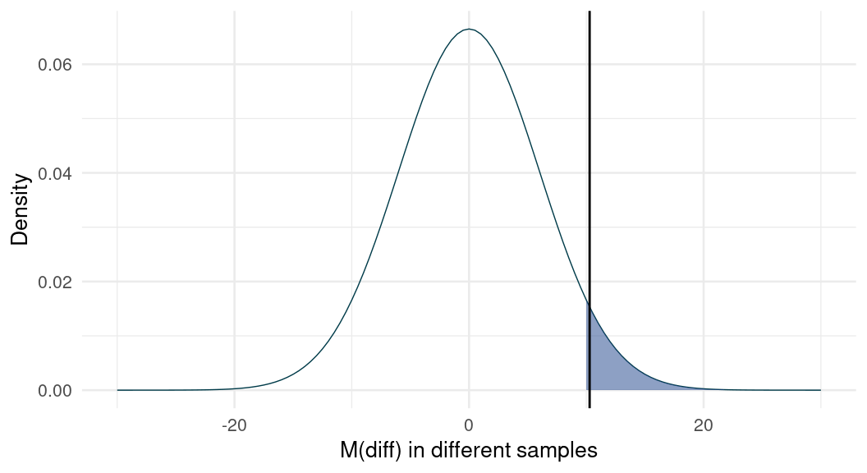
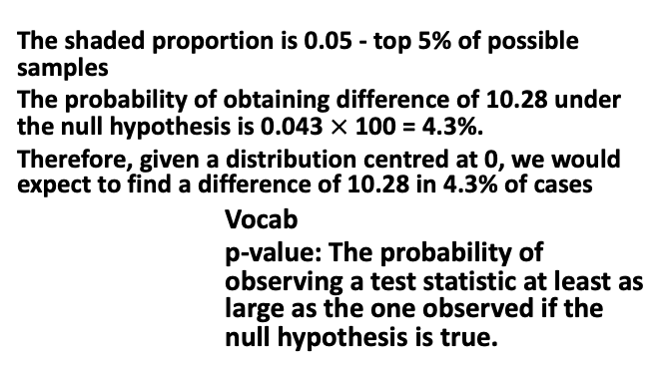
Compute the p-value
The shaded proportion is 0.05 - top 5% of possible samples
The probability of obtaining difference of 10.28 under the null hypothesis is 0.043 $×$ 100 = 4.3%.
Therefore, given a distribution centred at 0, we would expect to find a difference of 10.28 in 4.3% of cases
Vocab
p-value: The probability of observing a test statistic at least as large as the one observed if the null hypothesis is true.
pnorm(m_diff, 0, 6, lower.tail = FALSE)
[1] 0.04332562

Slide 34
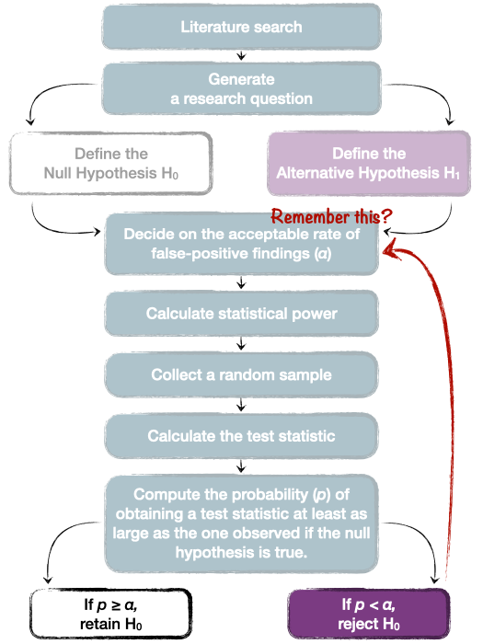
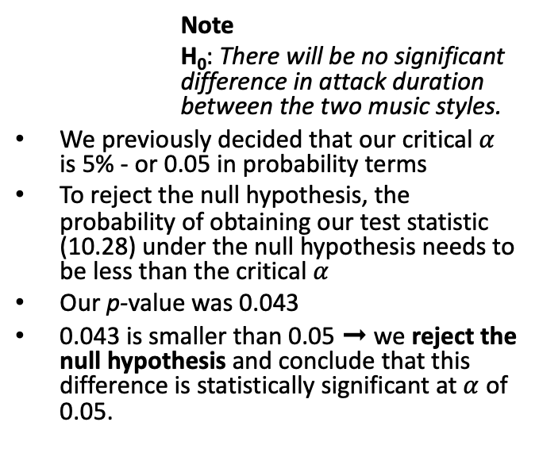
Retain or reject the null hypothesis
Note
H₀: There will be no significant difference in attack duration between the two music styles.
We previously decided that our critical $α$ is 5% - or 0.05 in probability terms
To reject the null hypothesis, the probability of obtaining our test statistic (10.28) under the null hypothesis needs to be less than the critical $α$
Our p-value was 0.043
0.043 is smaller than 0.05 ➞ we reject the null hypothesis and conclude that this difference is statistically significant at $α$ of 0.05.

Slide 35
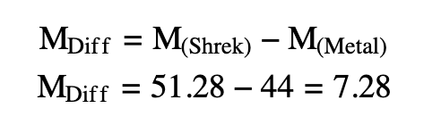
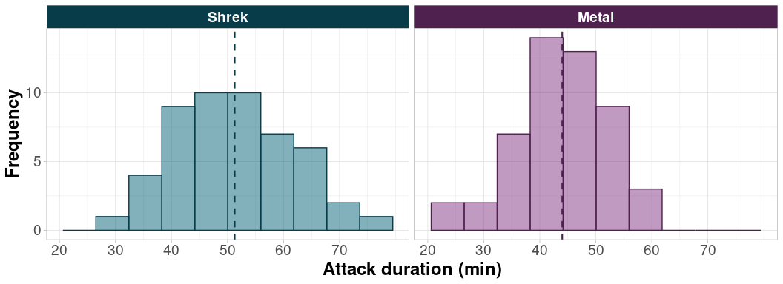
One more example…
Example 3:

Slide 36
One more example…
Shaded area is top 5%
The probability of finding a difference of 7.28 in a distribution centred at 0 is 0.112 (or in 11.2% of samples)
Is the difference of 7.28 in the shaded area?
pnorm(7.28, 0, 6, lower.tail = FALSE)
[1] 0.1125012

Slide 37
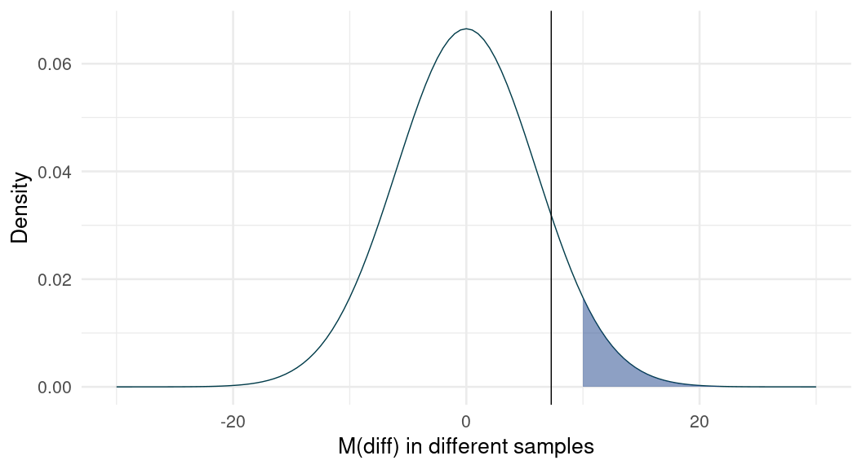
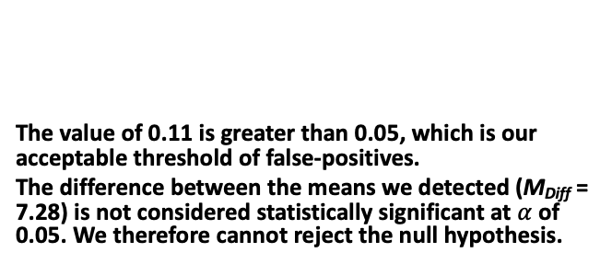
One more example…
The value of 0.11 is greater than 0.05, which is our acceptable threshold of false-positives.
The difference between the means we detected (M_{Diff} = 7.28) is not considered statistically significant at $α$ of 0.05. We therefore cannot reject the null hypothesis.
pnorm(7.28, 0, 6, lower.tail = FALSE)
[1] 0.1125012

Slide 38
Let’s practice (1)
We set the alpha level to be 0.05 (or 5%)
After receiving an intervention, a group of patients reports average anxiety score of 25.
The control group reports a score of 31, M_{diff} = 6
If the null hypothesis is true, probability of finding a difference of 6 is p = 0.02, or 2%.
Is this difference statistically significant?

Slide 39
Let’s practice (2)
We set the alpha level to be 0.05
We randomly sample and find that individuals who spend time with puppies report stress levels of 16, while individuals without puppies report stress levels of 19, M_{diff} = 3
We work out that: p = 0.04
Is this difference statistically significant?

Slide 40
Let’s practice (3)
Reported in a journal:
Participants in the active control group (M = 645, SD = 112) showed slower reaction times in milliseconds compared to those in the intervention group (M = 598, SD = 132), M_{diff} = 47, p = 0.073.
We set the alpha to be 0.05
Is this difference statistically significant?

Slide 41
Interpreting p-values

Slide 42
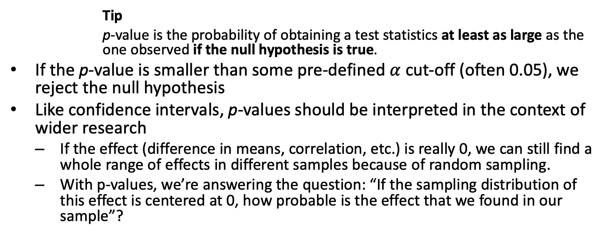
Interpreting p-values
Tip
p-value is the probability of obtaining a test statistics at least as large as the one observed if the null hypothesis is true.
If the p-value is smaller than some pre-defined $α$ cut-off (often 0.05), we reject the null hypothesis
Like confidence intervals, p-values should be interpreted in the context of wider research
If the effect (difference in means, correlation, etc.) is really 0, we can still find a whole range of effects in different samples because of random sampling.
With p-values, we’re answering the question: “If the sampling distribution of this effect is centered at 0, how probable is the effect that we found in our sample”?

Slide 43
🚨 Some INCORRECT definitions of p-values 🚨
Many(!) researchers find p-values difficult to interpret (Haller and Krauss 2002)
Warning
The p-value is NOT the probability of a chance result.
Warning
The p-value is NOT the probability of the alternative hypothesis being true.
Warning
The p-value is NOT the probability of the null hypothesis being true.

Slide 44
The inverse probability fallacy
Warning
The p-value is NOT the probability of the null hypothesis being true.
p-value doesn’t tell us anything about the probability of null or alternative hypothesis.
It tells us how likely the detected effect is IF the null is true.
We don’t know whether the null is true or not
Other statistical approaches - like Bayesian hypothesis testing - can tells more about the probability of null/alternative hypothesis, but we don’t cover them on this module.

Slide 45
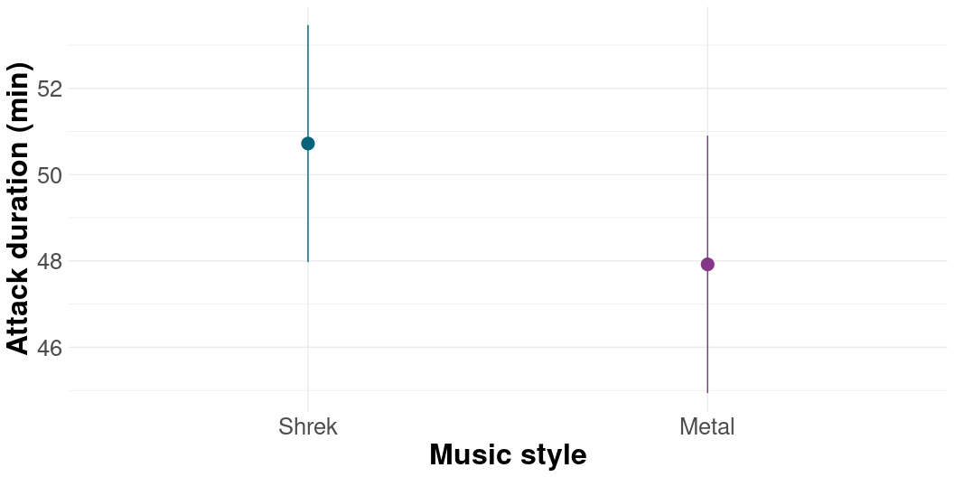
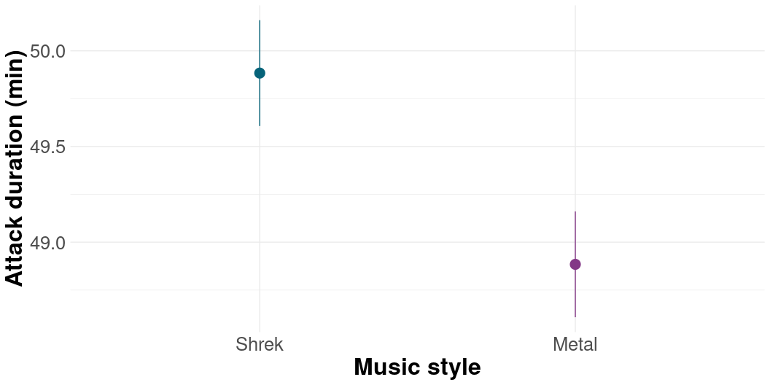
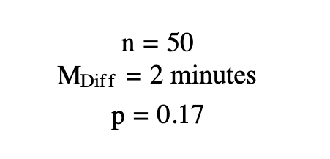
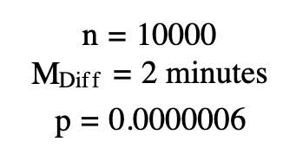
Some pitfalls of NHST
p-values are sensitive to sample size - any tiny difference can be statistically significant with large enough sample

Slide 46
Getting the most out of p-values
EFFECT SIZES - how large/meaningful is the effect (e.g. mean difference) that we found,
CONFIDENCE INTERVALS - what are the plausible limits of our effect?
POWER ANALYSIS - determining the necessary sample size before we begin data collection

Slide 47
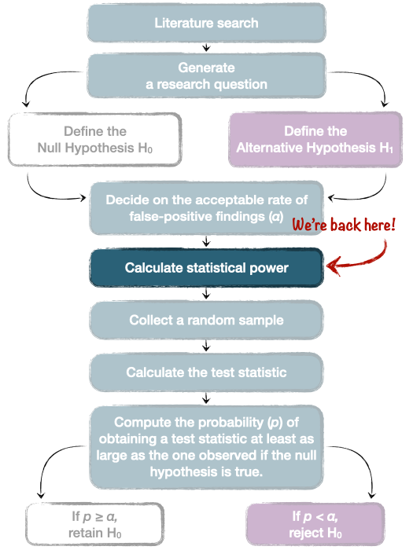
Power analysis
POWER ANALYSIS - determining the necessary sample size before we begin data collection to make sure we don’t under- or over-sample
STATISTICAL POWER - the probability of detecting an effect of a certain size as statistically significant, assuming the effect exists.
We assume a certain effect size - say that we’re only interested in an effect if it’s at least a difference of 10 minutes between Metal and Shrek music
We calculate the sample size necessary to detect this effect.
More participants are needed for (1) smaller effects and (2) complicated designs

Slide 48
Power analysis
Power analysis makes non-significant effects easier to interpret
Reduces the probability of missing an important finding (false-negative finding)³
Reduces over-sampling and wasting resources
Generally, a statistical power of 80% is considered the standard to aim for

Slide 49
In a nutshell…
NHST is the most commonly used way of testing hypotheses, but other methods exist
We start by defining our research questions and hypotheses.
We decide whether or not reject the null hypothesis based on the p-value associated with our test statistic
p-values can be a useful tool when combined with effect sizes, confidence intervals, preregistration/registered reports and power analysis

Slide 50
In a nutshell…
A p-value is:
The probability of observing a test statistic at least as large as the one we observed in our sample if the null hypothesis is true.
A p-value is NOT:
The probability that the null hypothesis is true
The probability that the alternative hypothesis is true
The probability of a chance result

Slide 51
Next week
Statistical foundations are over 🥳
Lectures, skills labs and tutorials start overlapping
Applying the NHST principles in practice - testing group differences using the t-test

Slide 52
References
Doyle, Lewis, Matthew J. Easterbrook, and Peter R. Harris. 2023. “Roles of Socioeconomic Status, Ethnicity and Teacher Beliefs in Academic Grading.” British Journal of Educational Psychology 93 (1): 91–112. https://doi.org/https://doi.org/10.1111/bjep.12541.
Drews-Windeck, Elea, Lindsay Evans, Kathryn Greenwood, and Kate Cavanagh. 2022. “The Implementation of a Digital Group Intervention for Individuals with Subthreshold Borderline Personality Disorder.” Procedia Computer Science 206: 23–33. https://doi.org/https://doi.org/10.1016/j.procs.2022.09.082.
Field, Andy P. 2018. “Discovering Statistics Using SPSS.”
Field, Andy P., and Jenny Terry. 2018. “A Pilot Study of Whether Fictional Narratives Are Useful in Teaching Statistical Concepts.” RSS Conference. https://discoveringstatistics.com/docs/rss_poster_2018.pdf.
Fincham, Guy William, Clara Strauss, Jesus Montero-Marin, and Kate Cavanagh. 2023. “Effect of Breathwork on Stress and Mental Health: A Meta-Analysis of Randomised-Controlled Trials.” Scientific Reports 13 (1): 432. https://doi.org/10.1038/s41598-022-27247-y.
Forman, Jemma, Elizabeth Renner, and David A. Leavens. 2023. “Fetching Felines: A Survey of Cat Owners on the Diversity of Cat (Felis Catus) Fetching Behaviour.” Scientific Reports 13 (1): 20456. https://doi.org/10.1038/s41598-023-47409-w.
Haller, Heiko, and Stefan Krauss. 2002. “Misinterpretations of Significance: A Problem Students Share with Their Teachers.” Methods of Psychological Research 7 (1): 1–20.
Mankin, Jennifer L., Christopher Thompson, Holly P. Branigan, and Julia Simner. 2016. “Processing Compound Words: Evidence from Synaesthesia.” Cognition 150: 1–9. https://doi.org/https://doi.org/10.1016/j.cognition.2016.01.007.
Woolston, Chris. 2019. “PhDs: The Tortuous Truth.” Nature. https://www.nature.com/articles/d41586-019-03459-7.

Slide 53
Notes
1. Graphic adapted from Field (2018)
2. Also called a “Type 1 error”
3. Also called Type 2 error.

